Slide 1
Week 5 Report
Jacob Lin

Slide 2
Summary
SIFT Key Point Matching
Keypoint with float coordinates
Accuracy assessment
AI Tools
Accuracy Assessment Idea
Closure

Slide 3
SIFT Key point matching
Brute force
Takes a key point in one image
Then calculates the norm with all the other key points in the second image
Then returns the highest
Can apply K-NN Nearest neighbors to get the K number of highest
Apply ratio test

Slide 4
Keypoint floats
The float in SIFT is caused by multiple things:
  Precision of SIFT algorithm
  Using difference of Gaussians which leads to noninteger coordinates
  Gaussian blurs
Should we include float point or round it off to integers?

Slide 5
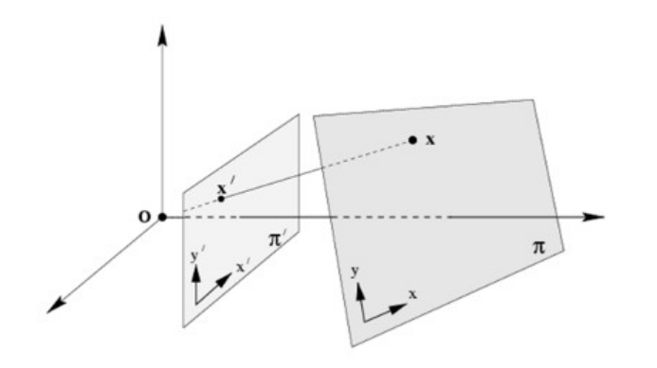
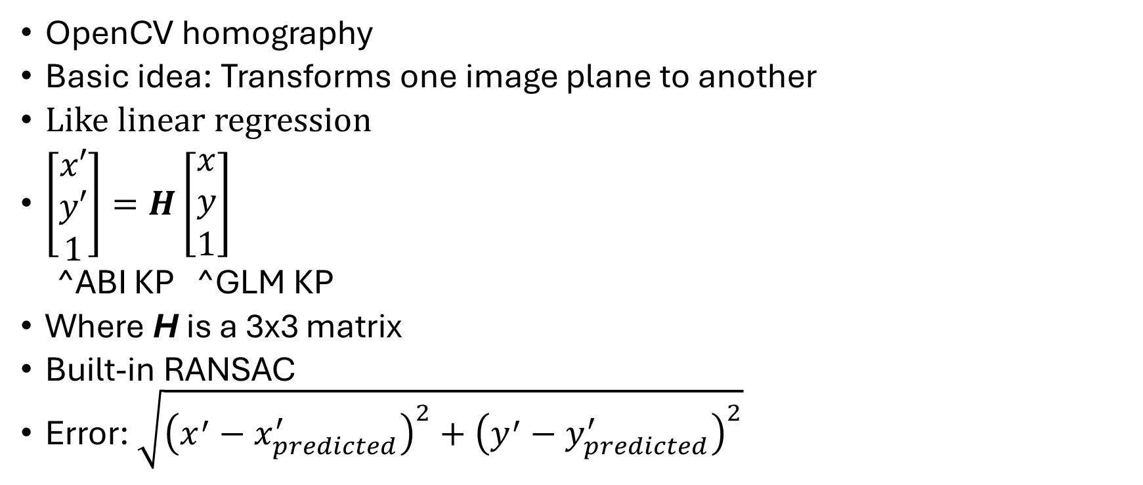
Accuracy assessment: Homography
OpenCV homography
Basic idea: Transforms one image plane to another
Like linear regression
$\left[\begin{aligned}x′ \\ y′ \\ 1\end{aligned}\right]=H\left[\begin{aligned}x \\ y \\ 1\end{aligned}\right]$
^ABI KP ^GLM KP
Where H is a 3x3 matrix
Built-in RANSAC
Error: $\sqrt{{\left(x^{′}−x_{predicted}^{′}\right)}^{2}+{\left(y^{′}−y_{predicted}^{′}\right)}^{2}}$

Slide 6
AI Tools
TensorFlow Keras
  High level API for TensorFlow
  Simplicity and easy to use
Superglue?
OpenCV SIFT Keypoint generation algorithm

Slide 7
Accuracy Assessment Idea
Take key points of GLM and match them to a key point in ABI:
  For every pair of images:
    Use SIFT to calculate key points for both ABI and GLM
    For every keypoint in GLM:
      Calculate the predicted ABI keypoint
        Check if it is a keypoint in ABI?
      Find nearest point
      Use Euclidean distance to calculate error with the correct key point
Concern:
  Not every ABI key point matches with the GLM keypoints
  How to confirm the points?
    Idea: split ¼ of the matched points, use it as testing

Slide 8
Closure
No major questions
July 4th approval
Just need time to code

